Slide 1

Reproducing Bayesian Constraints on Cosmological Parameters and Lorentz Invariance
B. tech. Project II - 6th Semester
Ramagiri Jaidhar - EP23BTECH11021
Supervisor - Dr. Shantanu Desai

Slide 2
Project Overview & Motivation
This project replicates findings from two different research papers which use Bayesian approaches in cosmology and high energy astrophysics.
In the first paper, H(z) data from cosmic chronometers is used to test cosmological models such as ΛCDM to understand any systematics involved and uses Bayesian approaches.
In the second paper, a hierarchical Bayesian approach is used in investigating potential violations of Lorentz invariance using GRB spectral lag data.
Bayesian analysis involves building up likelihoods, selecting appropriate priors, and finding posteriors using MCMC.
The results obtained in this project replicate those of the original papers, except for some minor variations due to simplifying assumptions in the analysis.

Slide 3
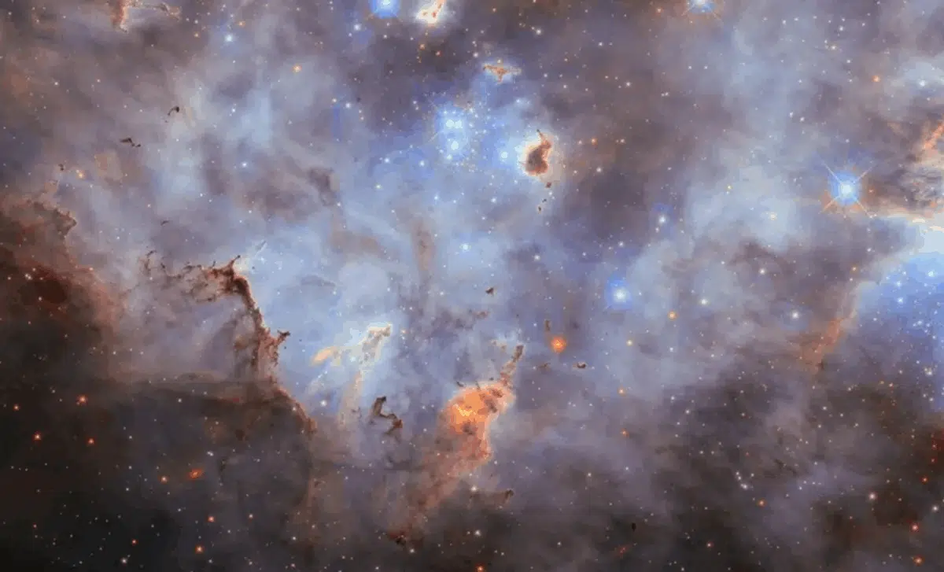
Cosmic Chronometer Analysis H(z)
This Photo by Unknown Author is licensed under CC BY-SA

Slide 4

Theoretical Foundation
The current standard model of cosmology (ΛCDM model) assumes that the Universe is homogeneous and isotropic on large scales this is governed by Friedmann Lemaıtre Robertson Walker (FLRW) metric
the Hubble parameter for a non-flat ΛCDM model (OΛCDM) :
In case of a spatially flat Universe (Ωk = 0), the model simplifies to:
where H(z) is expansion rate, H0 is the present-day Hubble constant, and Ωm, Ωk, and ΩΛ are the density parameters corresponding to matter, curvature, and dark energy, respectively.
Cosmic chronometers use the differential age of galaxies to measure H(z) without assuming a specific model

Slide 5

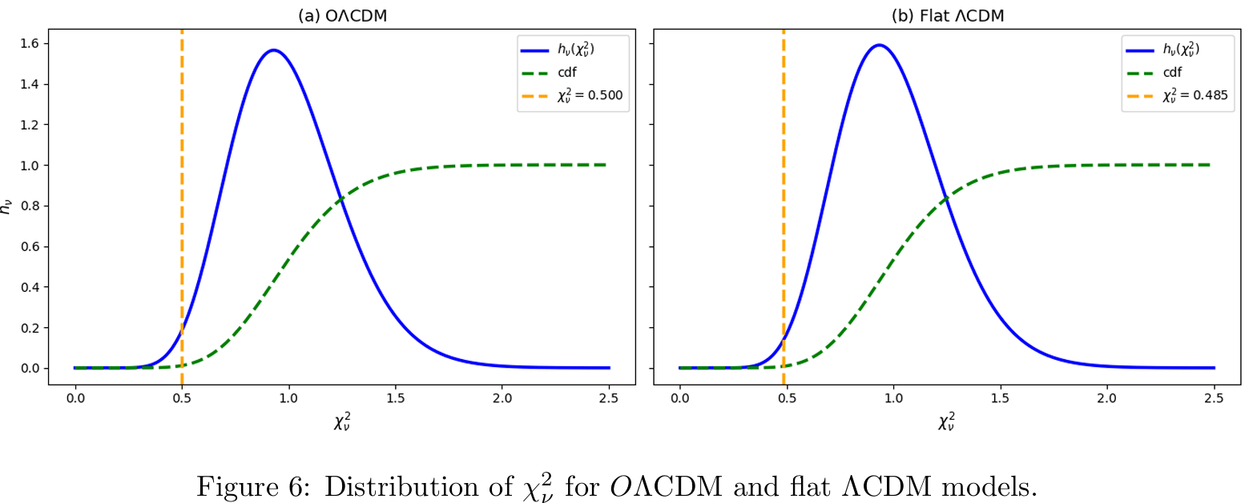


Methodology – H(z) Analysis
Dataset: 32 cosmic chronometer measurements across various redshifts.
Goodness-of-Fit Analysis: Initial χ2 suggests observational uncertainties in the H(z) dataset are overestimated
Bayesian Correction: Introduced a correction factor f to rescale the uncertainties.
The chi-square statistic is evaluated numerically as:
The corresponding log-likelihood is implemented as:

Slide 6

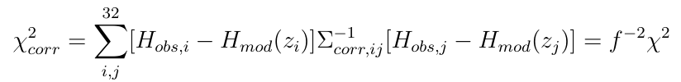

Methodology – H(z) Analysis
The most rigorous way to correct the uncertainties would be to apply a correction factor to each individual data point. However, since we aim to avoid introducing more free parameters than data points, we will apply the same correction factor f to all uncertainties.
we must introduce a f factor for each element of the covariance matrix. This ensures that the correlation between data points remains unchanged while applying the correction.
the corrected χ2 is :
The corrected log-likelihood is implemented as:

Slide 7
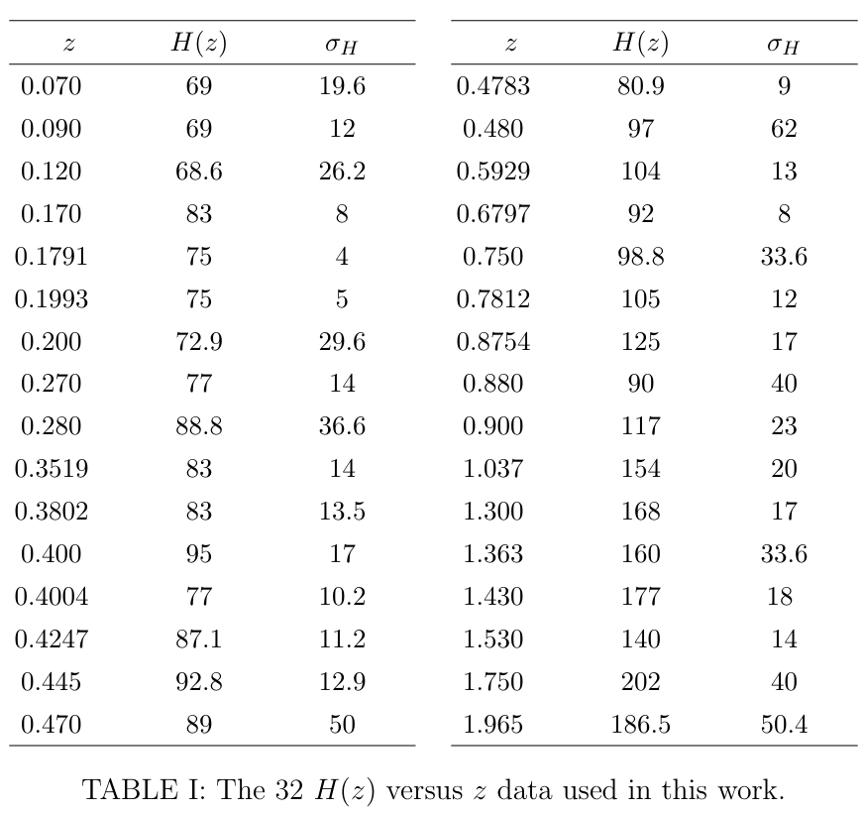
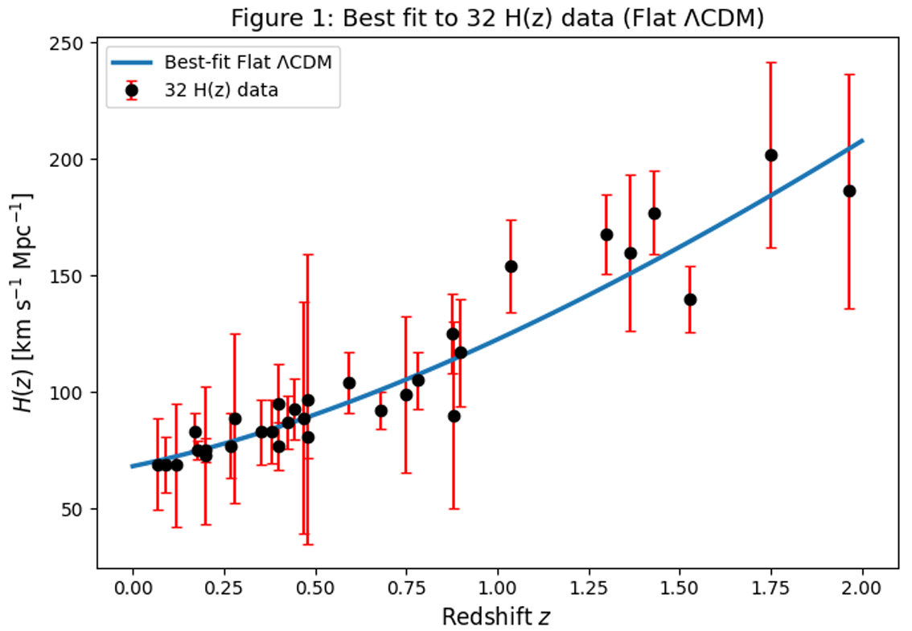
Data used:

Slide 8
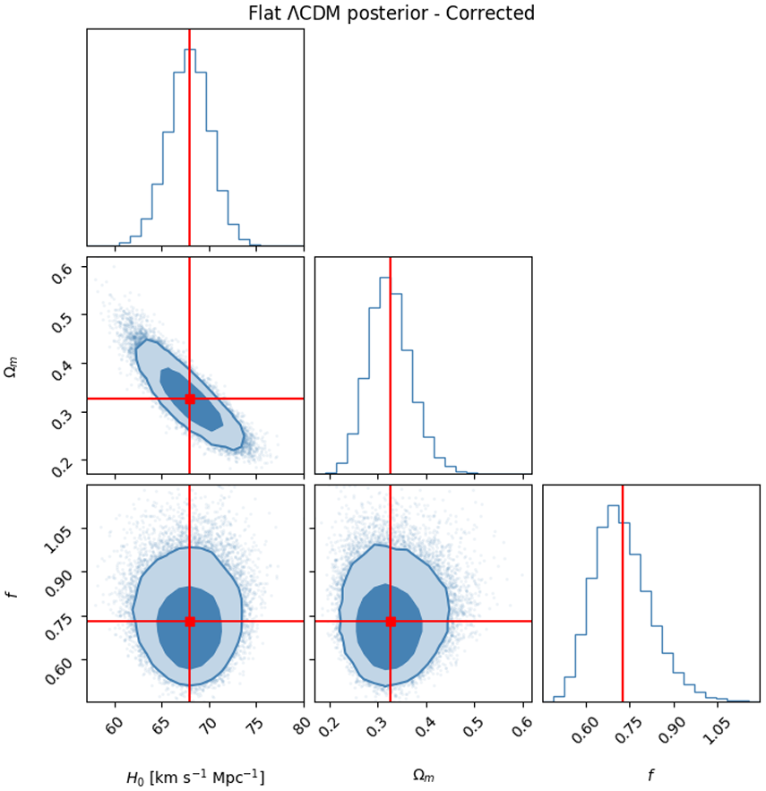
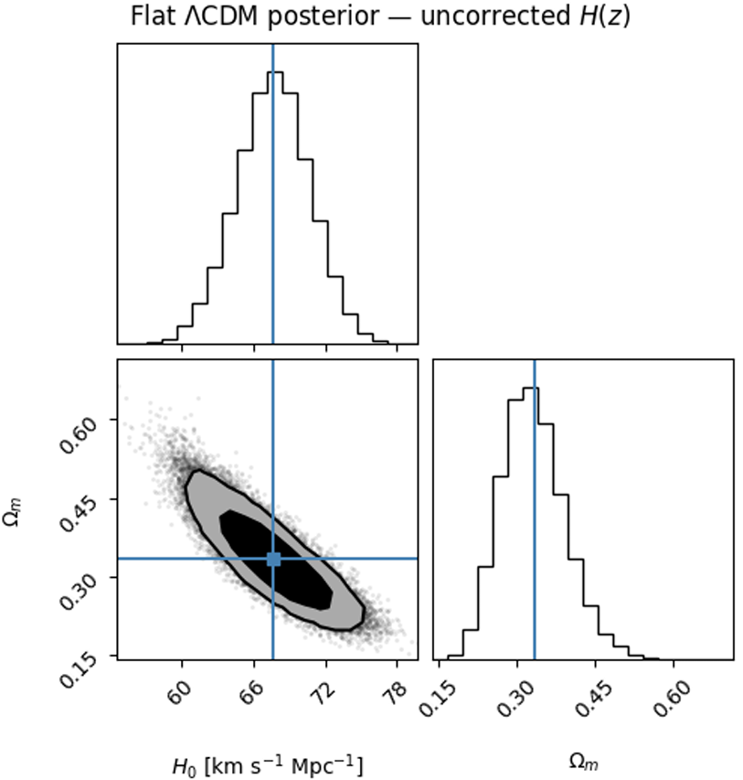
Results flat ΛCDM:

Slide 9
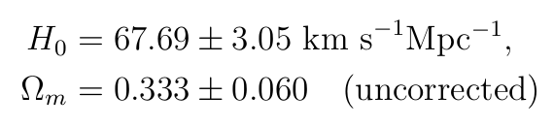
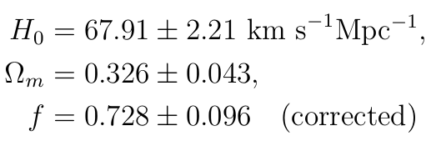
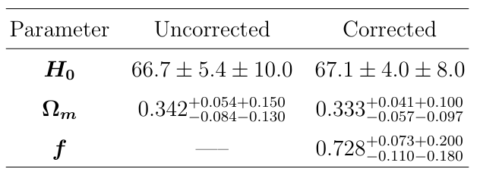
Results flat ΛCDM:
Uncorrected:
Corrected:
We observe that the inclusion of the correction factor f reduces the uncertainties in both H0 and Ωm, consistent with the findings of Kvint et al.
Our results agree with these values, although the constraints are tighter in the latter case.
The gain in accuracy is due to the Bayesian correction term, which compensates for an overestimation of the observational uncertainties.
Reference results

Slide 10
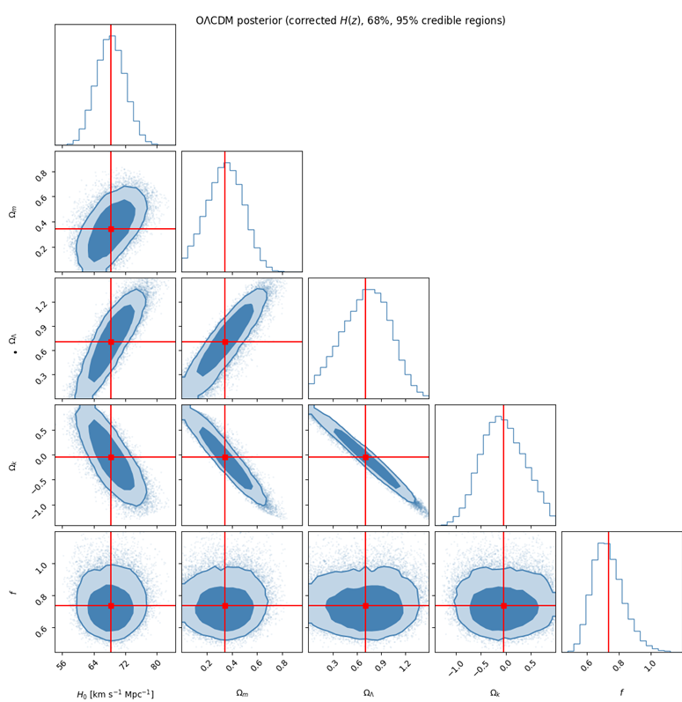
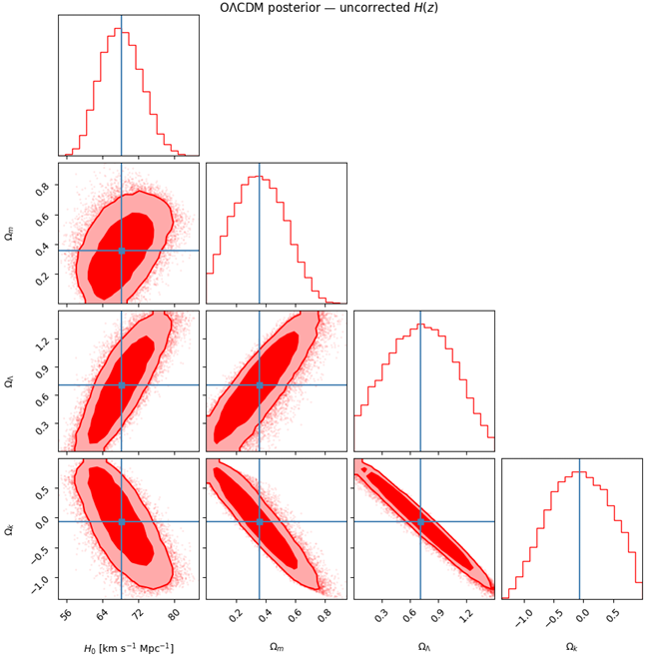
Results Open ΛCDM :

Slide 11
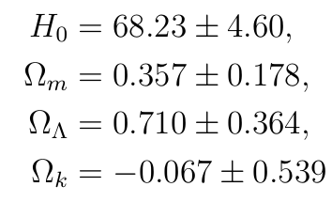
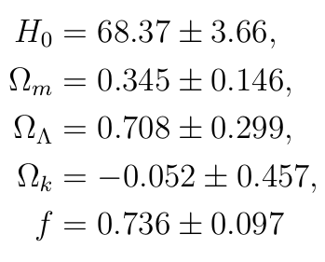
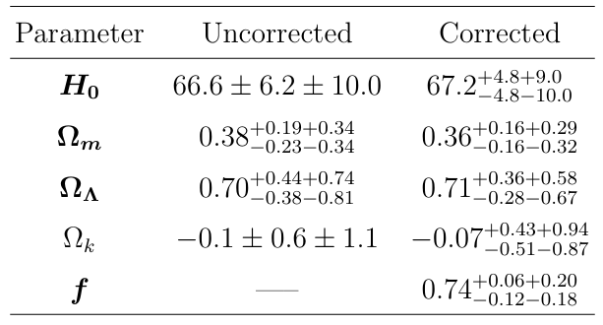
Results Open ΛCDM :
Uncorrected
Our results are consistent within 1σ uncertainties. The curvature parameter Ωk is consistent with zero, supporting a spatially flat universe within uncertainties.
Corrected:
Reference results

Slide 12
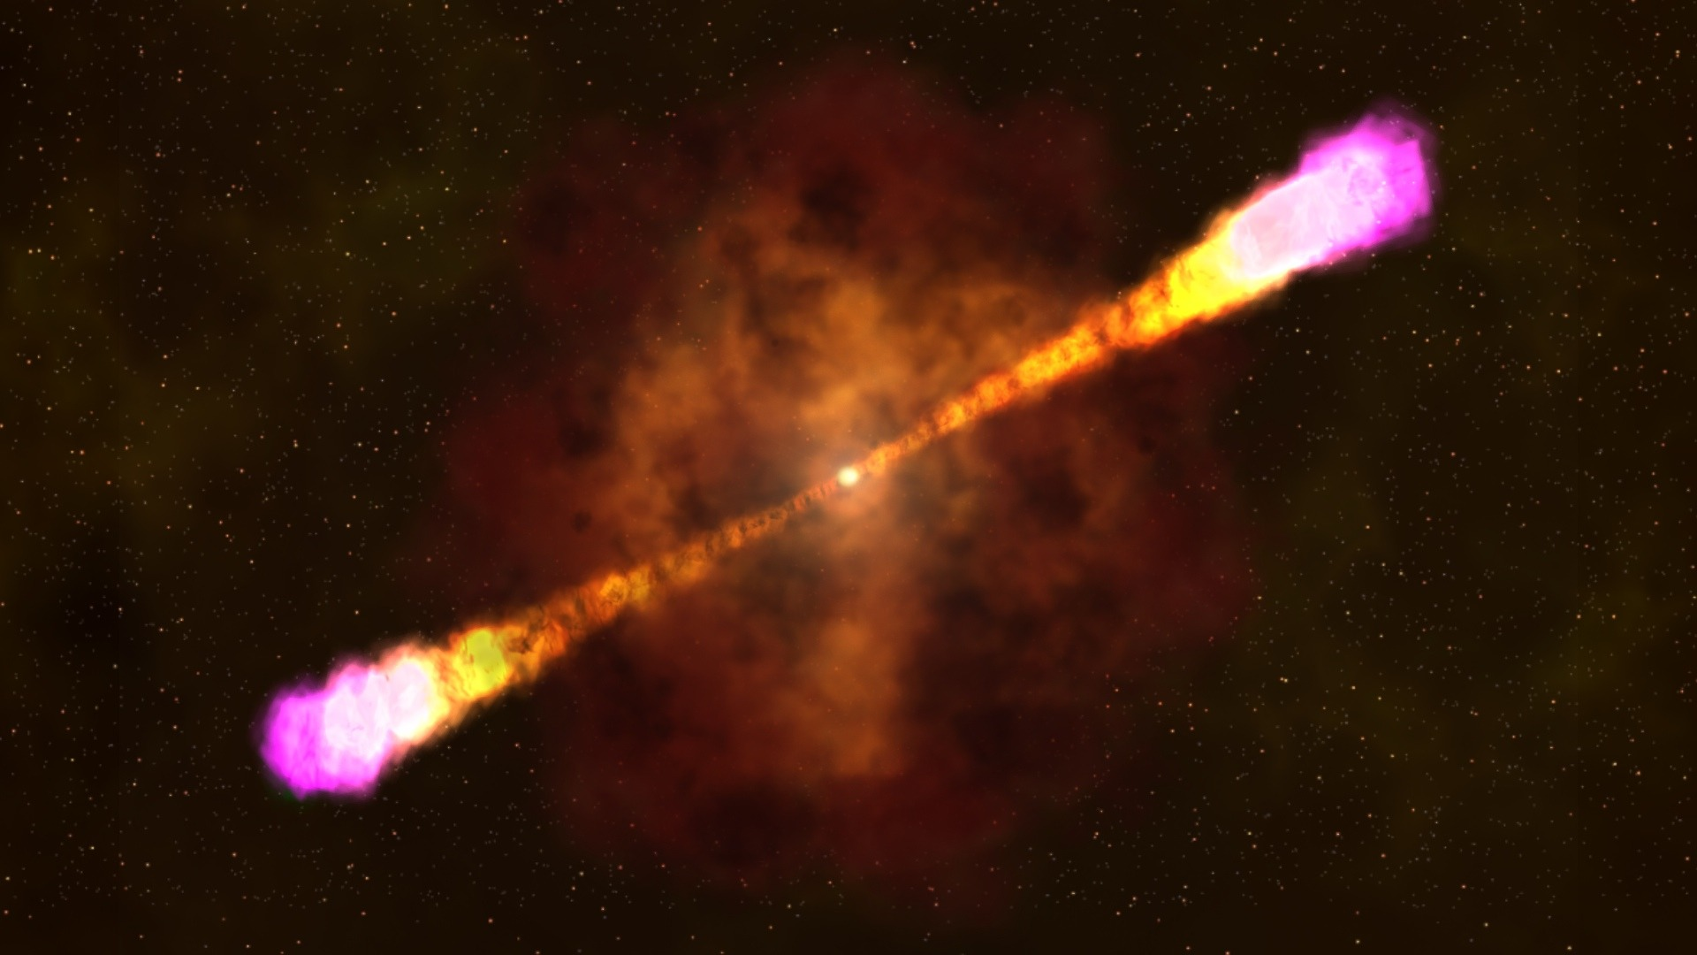
GRB Analysis and Lorentz Invariance Violation
This Photo by Unknown Author is licensed under CC BY-SA-NC
This Photo by Unknown Author is licensed under CC BY-SA

Slide 13

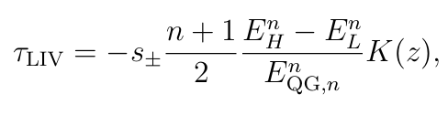
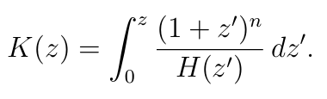
Theoretical Foundation
Gamma-ray bursts (GRBs) are the most powerful, luminous explosions in the universe which are resulting from the deaths of massive stars or the merger of compact stellar remnants.
Some quantum gravity theories predict that speed of light may depend on photon energy, this violates Lorentz invariance.
The Planck energy scale is the theoretical energy level at which quantum effects of gravity become significant.
GRBs occur at cosmological distances (billions of light-years), tiny LIV effects accumulate over such long distances.
So total time we observe is
where Tint represents intrinsic source effects.

Slide 14
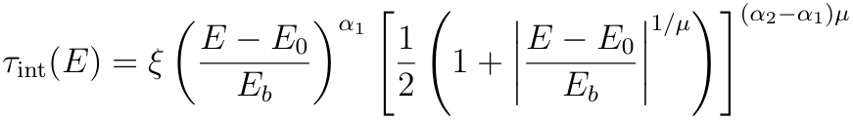
Theoretical Foundation
In practice, parametric models (such as smooth broken power laws) , non-parametric methods (such as cubic spline interpolation) are employed to account for these effects.
For the non-parametric approach, τint(E) = Spline(E)
The spline is constructed using weighted least squares, this approach allows flexibility in capturing complex intrinsic lag behavior.
For the parametric approach(SBPL model)
ξ is the normalization,
Eb is the break energy,
α1 and α2 are spectral indices
µ controls the smoothness of the transition
E0 is the reference energy.

Slide 15
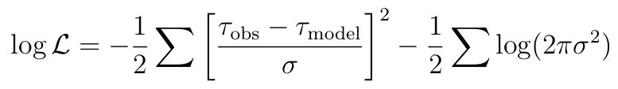
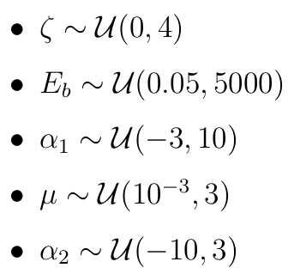
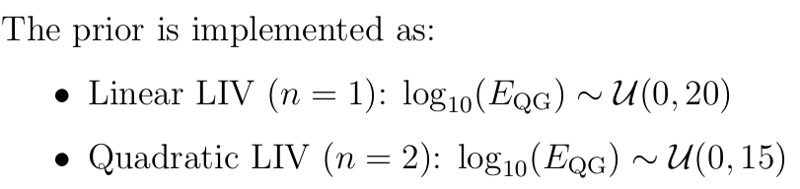
Methodology
The likelihood is constructed assuming Gaussian errors:
Where σ includes both observational uncertainty and propagated LIV uncertainty
For SBPL the uniform priors are assigned to all parameters.
For both cubic spline and SBPL models, the quantum gravity energy scale is parameterized in logarithmic form log10(EQG)

Slide 16
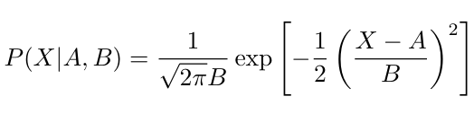
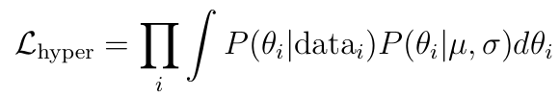
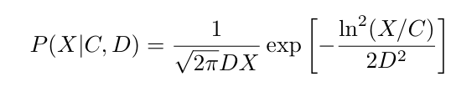
Hierarchical Bayesian Analysis
To combine information from 32 GRBs, a hierarchical Bayesian framework is implemented.
Posterior samples from individual GRBs are used as inputs to a higher-level model and distribution of log10(EQG) across bursts is modeled using Gaussian distribution and Log-normal distribution.
The hierarchical likelihood is constructed as:
where (µ,σ) are hyperparameters describing the population distribution
Gaussian distribution
log-normal distribution

Slide 17
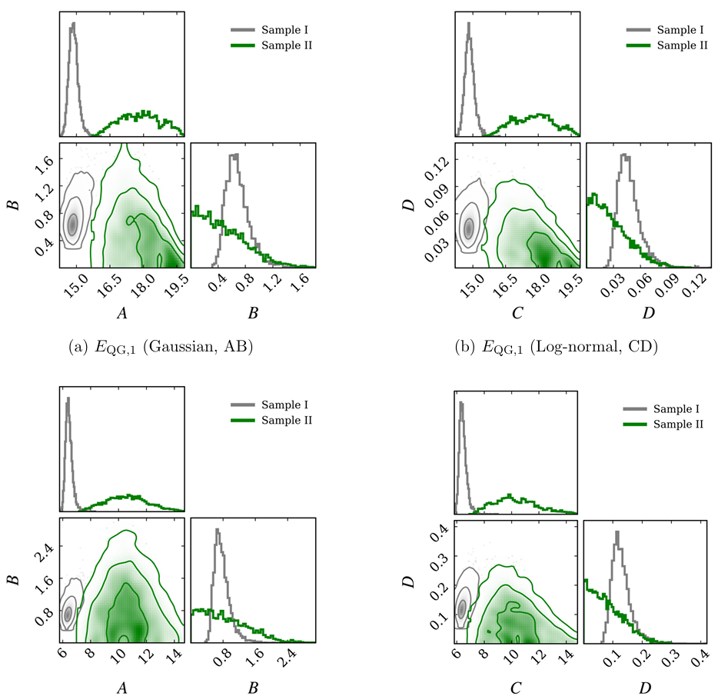
Results:
One-and Two-dimensional marginal posterior probability distributions of hyper-parameters.
A & B for Gaussian and C & D are for log-normal distribution model.
The top row corresponds to linear LIV (n =1) and the bottom row to quadratic LIV (n =2).
Sample I: A parametric model.
Sample II: A cubic spline model.

Slide 18
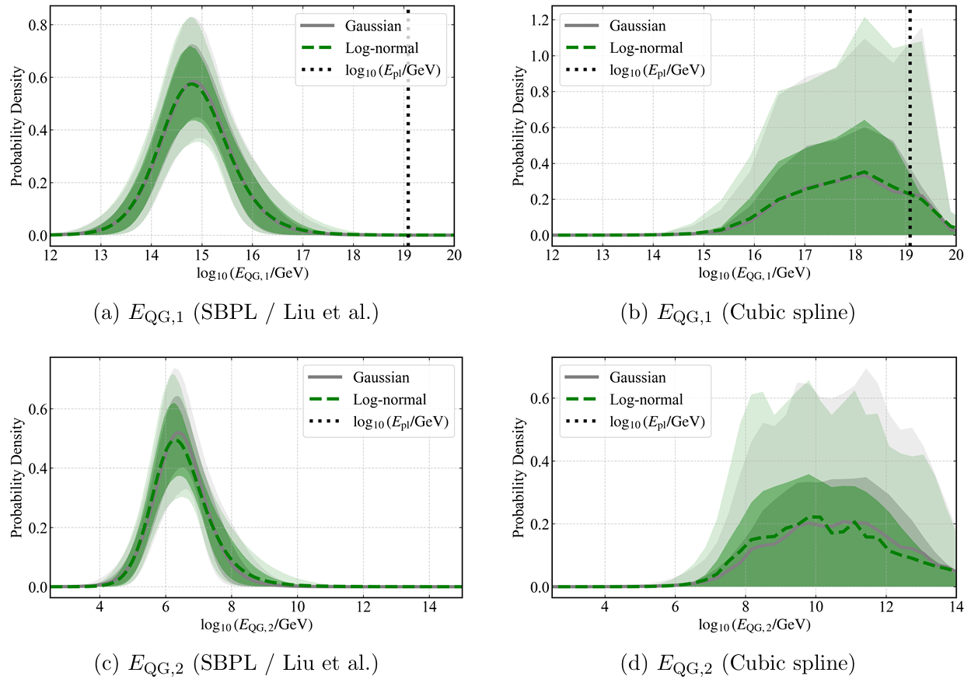
Results:
Posterior predictive distributions of log10(EQG) obtained from the hierarchical Bayesian analysis.
The top row corresponds to linear LIV (n = 1) and the bottom row to quadratic LIV (n = 2).
The left column shows results using the SBPL intrinsic lag model (Liu et al.), while the right column corresponds to the cubic spline model.
The vertical dashed line indicates the Planck energy scale.

Slide 19
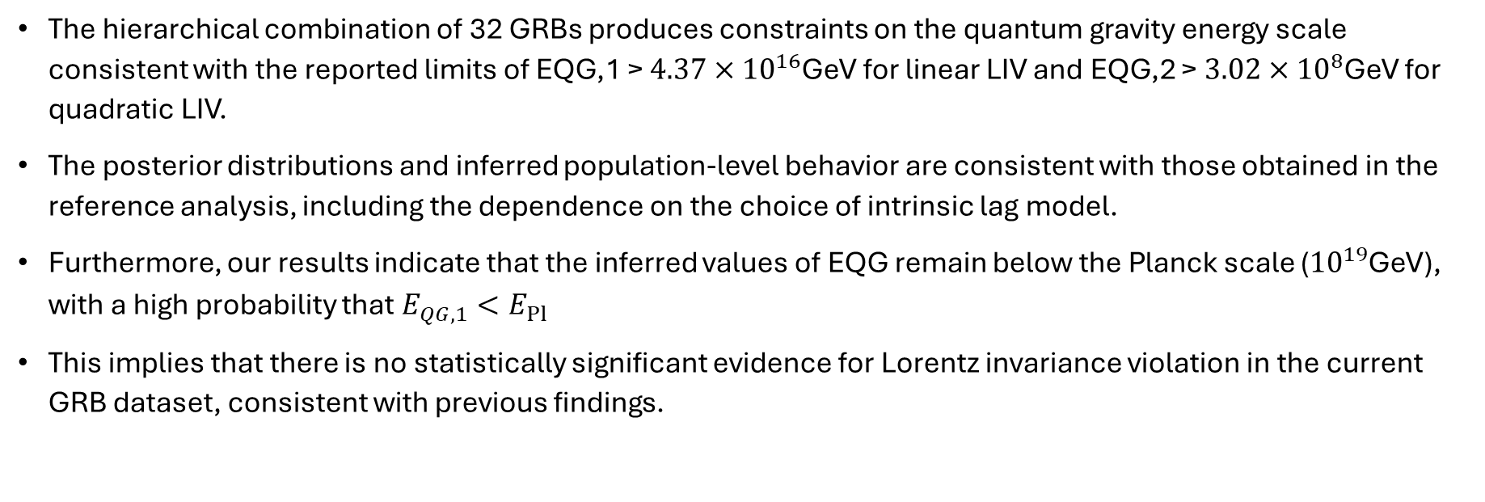
Discussion and Conclusion
The hierarchical combination of 32 GRBs produces constraints on the quantum gravity energy scale consistent with the reported limits of EQG,1 > $4.37×{10}^{16}$GeV for linear LIV and EQG,2 > $3.02×{10}^{8}$GeV for quadratic LIV.
The posterior distributions and inferred population-level behavior are consistent with those obtained in the reference analysis, including the dependence on the choice of intrinsic lag model.
Furthermore, our results indicate that the inferred values of EQG remain below the Planck scale (${10}^{19}$GeV), with a high probability that $E_{QG,1}<E_{Pl}$
This implies that there is no statistically significant evidence for Lorentz invariance violation in the current GRB dataset, consistent with previous findings.

Slide 20

Thank you

